Slide 1
Aggregation & Inheritance
Source from Tony Gaddis, Starting out with C++, 8th edition update.

Slide 2
Week 13.7
Aggregation & Composition

Slide 3
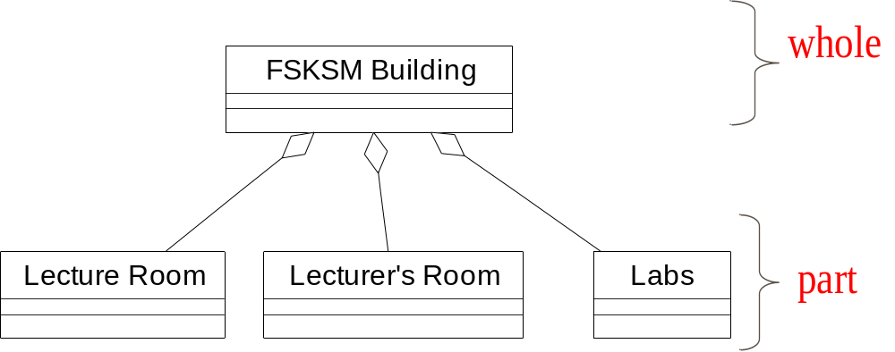
Aggregation
a class is a member of a class
Supports the modeling of ‘has a’ relationship between classes
FK Building

Slide 4
Composition
Models a whole/part relationship with a strong ownership; when the whole dies, the part does so as well
An object can be only part of one whole object
The whole part is responsible for creation and destruction of its part

Slide 5
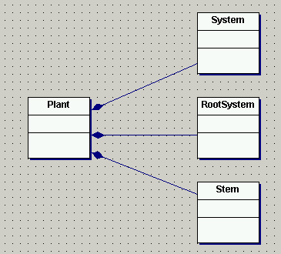
Composition

Slide 6
Aggregation & Composition Implementation
There are two basic ways in which aggregations are implemented
  Objects contain objects (fixed aggregation / composition)
  Objects contain pointers to objects (variable aggregation)

Slide 7
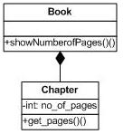
Fixed aggregations / Composition
Fixed aggregations / compositions are implemented by using a class type as an attribute type in the aggregate class.

Slide 8
Example of Fixed Aggregation
class Chapter{
int no_of_pages;
public:
Chapter(int pages);
int get_pages();
};
Chapter::Chapter(int pages){
no_of_pages = pages;
}
int Chapter::get_pages(){
return no_of_pages;
}
Constructor for Chapter
class takes an integer
argument to define
its pages

Slide 9
Example of Fixed Aggregation
Class attributes now
include objects of
other classes
class Book{
public:
Chapter c1, c2, c3, c4;
Book(int pages1, int pages2, int pages3,
int pages4):c1(pages1), c2(pages2),
c3(pages3),c4(pages4){ }
void showNumberofPages();
};
void Book:: showNumberofPages(){
cout<<"Total number of pages" <<
(c1.get_pages() + c2.get_pages()+
c3.get_pages() + c4.get_pages());
}
int main(){
Book TP2(200, 190, 50, 100);
TP2.showNumberofPages();
}
Note use of colon(:) operator to pass parameters sent to
constructor of aggregated
object to the constructors
of the constituent objects
Book class methods
can now call methods
of the Chapter objects

Slide 10
Variable Aggregations
A component may not always be present at runtime. Therefore, we may represent it using a pointer to an object rather than by an object itself.
Example:
  A lecturer may be assigned a course to teach. That lecturer may be removed from that course at anytime. The relationship is one that may change. Hence a fixed aggregation / composition is unsuitable for representing this relationship. Variable aggregation is more suitable

Slide 11
Variable Aggregation
Variable aggregation - declare attributes as object pointers rather than standard data types.
Pointers can be set to NULL to represent no object
  class car
  {
  private:
  person * theDriver = NULL;
  ..};
Class attributes now
include pointers to
objects of other classes

Slide 12
Example of Variable Aggregation
We could have a method
which instantiates an object
of the contained class
and allocates it to the
pointer like this..
  car::addDriver(){
  theDriver=new person;
  }
  car::removeDriver(){
  delete theDriver;
  theDriver=NULL;
  }
..and deletes it like this

Slide 13
Example of Variable Aggregation
#include <iostream>
#include <string>
using namespace std;
class Person{
string name;
public:
Person(string name=" "){
this->name=name;
}
void set(string a){
name=a;
}
void print() {
cout<<name<<endl;
}};
class Car
{ string model;
string year;
Person *driver;
public:
Car(string model=" ",
string year=" ");
void addDriver();
void deleteDriver();
void print();
};

Slide 14
Example of Variable Aggregation
void Car::print(){
driver->print();
cout<<model<<endl;
cout<<year<<endl;
}
int main(){
Car car1("Honda","2006");
car1.addDriver();
car1.print();
}
Car::Car(string a, string b){
model=a;
year=b;
}
void Car::addDriver(){
driver=new Person;
driver->set("Ani");
}
void Car::deleteDriver(){
delete driver;
driver=NULL;
}

Slide 15
Aggregation in UML diagrams (fixed aggregation)
Draw relationship between a Point class and a Circle class.
A point is an aggregate of the circle. When the circle class is destructed so will the point class.
Aggregate symbol used is darkened diamond.

Slide 16
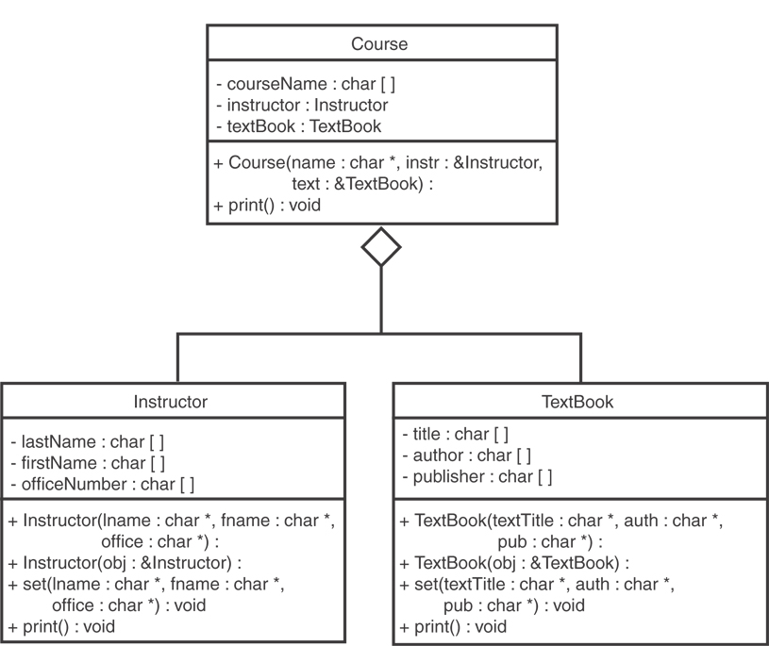
Aggregation in UML diagrams (variable aggregation)

Slide 17
Exercise Week 14_1
Refer to Exercise 1 Question 1 and 2 in Lab 11 pg. 187-188 (class diagrams)
Refer to Exercise 2 Question 1 and 3 in Lab 11 pg. 193-194 (trace)
Submit Ex.2 Q.3 (before tomorrow’s class)

Slide 18
Week 14.1
Inheritance

Slide 19
What Is Inheritance?
Provides a way to create a new class from an existing class
The new class is a specialized version of the existing class
Classes organised into a ‘classification hierarchy’
Classes can inherit attributes and methods from other classes
Inheriting class can add extra attributes and or methods of its own

Slide 20
What is the purpose of Inheritance?
Specialisation
  Extending the functionality of an existing class
Generalisation
  sharing commonality between two or more classes
Improved efficiency and greater robustness

Slide 21
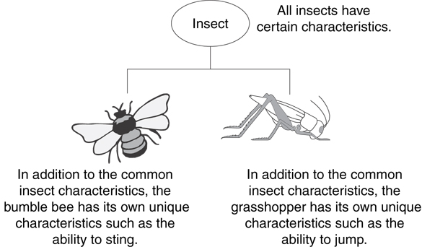
Example: Insects

Slide 22
The "is a" Relationship
Inheritance establishes an "is a" relationship between classes.
  A poodle is a dog
  A car is a vehicle
  A flower is a plant
  A football player is an athlete

Slide 23
Inheritance – Terminology
Base class or parent class or super class – A class from which another class inherits
Derived class or child class or subclass – A class which inherits some of its attributes and methods from another class
Building
base class
Commercial
Public
Domestic
Derived class

Slide 24
Inheritance – Notation
  class Student // base class
  {
  . . .
  };
  class UnderGrad : public student
  { // derived class
  . . .
  };

Slide 25
Back to the ‘is a’ Relationship
An object of a derived class 'is a(n)' object of the base class
Example:
  an UnderGrad is a Student
  a Mammal is an Animal
A derived object has all of the characteristics of the base class

Slide 26
Back to the ‘is a’ Relationship
Building
base class
Commercial
Public
Domestic
A ‘kind of’ Building

Slide 27
What Does a Child Have?
An object of the derived class has:
all members defined in child class
all members declared in parent class
An object of the derived class can use:
all public members defined in child class
all public members defined in parent class

Slide 28
Week 14.2
Protected Members and Class Access

Slide 29
Protected Members and Class Access
protected member access specification: like private, but accessible by objects of derived class
Class access specification: determines how private, protected, and public members of base class are inherited by the derived class

Slide 30
Class Access Specifiers
public – object of derived class can be treated as object of base class (not vice-versa)
protected – more restrictive than public, but allows derived classes to know details of parents
private – prevents objects of derived class from being treated as objects of base class.

Slide 31
Inheritance vs. Access
How inherited base class members
appear in derived class
Base class members
private: x
protected: y
public: z
private
base class
x is inaccessible
private: y
private: z
private: x
protected: y
public: z
protected
base class
x is inaccessible
protected: y
protected: z
private: x
protected: y
public: z
public
base class
x is inaccessible
protected: y
public: z

Slide 32
More Inheritance vs. Access
class Grade
class Test : public Grade
private members:
char letter;
float score;
void calcGrade();
public members:
void setScore(float);
float getScore();
char getLetter();
private members:
int numQuestions;
float pointsEach;
int numMissed;
public members:
Test(int, int);
private members:
int numQuestions:
float pointsEach;
int numMissed;
public members:
Test(int, int);
void setScore(float);
float getScore();
float getLetter();
When Test class inherits
from Grade class using
public class access, it looks like this:

Slide 33
More Inheritance vs. Access (2)
class Grade
class Test : protected Grade
private members:
char letter;
float score;
void calcGrade();
public members:
void setScore(float);
float getScore();
char getLetter();
private members:
int numQuestions;
float pointsEach;
int numMissed;
public members:
Test(int, int);
private members:
int numQuestions:
float pointsEach;
int numMissed;
public members:
Test(int, int);
protected members:
void setScore(float);
float getScore();
float getLetter();
When Test class inherits
from Grade class using
protected class access, it looks like this:

Slide 34
More Inheritance vs. Access (3)
class Grade
class Test : private Grade
private members:
char letter;
float score;
void calcGrade();
public members:
void setScore(float);
float getScore();
char getLetter();
private members:
int numQuestions;
float pointsEach;
int numMissed;
public members:
Test(int, int);
private members:
int numQuestions:
float pointsEach;
int numMissed;
void setScore(float);
float getScore();
float getLetter();
public members:
Test(int, int);
When Test class inherits
from Grade class using
private class access, it looks like this:

Slide 35
C++ Syntax: public derivation
A derived class.
The colon operator means
the derived class
inherits from
the base class
class DerivedClass: public BaseClass
{
private:
  int y;
public:
  void setY(int y_in);
  int getY();
}
the public derivation means
that objects of the derived class
can access the public methods
and attributes of the base class
This is the most usual type
of derivation

Slide 36
C++ Syntax: public derivation
main()
{
BaseClass base_object;
DerivedClass der_object;
base_object.setX(7);
der_object.setX(12);
der_object.setY(1);
return 0;
}
class BaseClass{
private:
  int x;
public:
  void setX(int x_in);
  int getX();
}
class DerivedClass: public BaseClass
{
private:
  int y;
public:
  void setY(int y_in);
  int getY();
}
Object of the derived
class can access methods
of the derived class
and also methods of the
base class

Slide 37
Exercise Week 14_3
Refer to Exercise 3 Question 1 and 2 in Lab 11 pg. 204-205
Refer to Exercise 3 Question 5 in Lab 11 pg. 206
Solve the problems

Slide 38
Lab Exercise Week 14_4
Refer to Ex.1 Q.3 in Lab 11 pg. 189-190
Refer to Ex.2 Q.6 in Lab 11 pg. 199-201
Solve the problems
Submit on the 15th May 2014 - Hardcopy

Slide 39
Week 14.3
Constructors and Destructors in Base and Derived Classes

Slide 40
Constructors and Destructors in Base and Derived Classes
Derived classes can have their own constructors and destructors
When an object of a derived class is created, the base class’s constructor is executed first, followed by the derived class’s constructor
When an object of a derived class is destroyed, its destructor is called first, then that of the base class

Slide 41
Example
#include <iostream>
class BaseClass
{
public:
BaseClass()
{
cout<<"Running base class constructor"<<endl;
}
~BaseClass()
{
cout<<"Running base class destructor"<<endl;
}
};

Slide 42
Example
class DerivedClass:public BaseClass{
public:
DerivedClass()
{
cout<<"Running derived class constructor"<<endl;
}
~DerivedClass()
{
cout<<"Running derived class destructor"<<endl;
}
};
int main(){
DerivedClass a;
return 0;
}
Run after BasedClass constructor
Run before BasedClass destructor

Slide 43
C++ Syntax: inheriting constructors
A derived class always inherits the constructor of the base class.
If the base class constructor takes no parameters then the inheritance is implicit - you don’t need to do anything!
If the base class constructor takes parameters then each derived class needs to declare a constructor with the same parameters.
You can pass the arguments given to the derived class constructor to the constructor for the base class

Slide 44
C++ Syntax: inheriting constructors
Base class declares a
constructor that takes
a char pointer parameter
class Customer
{
Customer (char * name_in);
…
}
Class AccountCustomer:public Customer
{
AccountCustomer(char * name_in);
..
}
Derived class declares a
constructor that takes the
same char pointer parameter

Slide 45
C++ Syntax: inheriting constructors
AccountCustomer: AccountCustomer(char * name_in):
Customer (name_in)
{
//main body of constructor..
}
In the implementation of the constructor for the derived class, the parameter passed to the
derived class constructor is passed down to the base class constructor. Note use of the colon (:) syntax once again

Slide 46
Passing Arguments to Base Class Constructor
derived class constructor
base class constructor
Square::Square(int side):Rectangle(side,side)
derived constructor parameter
base constructor parameters

Slide 47
Example
#include <iostream>
class Rectangle{
int length, width;
public:
Rectangle(int length, int width)
{ this->length=length;
this->width=width;
}
void display()
{cout<<width<<endl;
cout<<length<<endl;}
};
This class has a constructor
that takes an integer arguments.
class Box:public Rectangle{
int height;
public:
Box (int height,int length, int width) :Rectangle(length,width)
{ this->height=height; }
Box(int l, int w):Rectangle(l,w){}
};
int main(){
Box a(5,7,10);
Box b(8,9);
b.display();
a.display()}
Box class derived from
creature class

Slide 48
Exercise Week 14_5
Refer to Exercise 2 Question 6 iv and v in Lab 11 pg. 173-174
Solve the problems

Slide 49
Redefining Base Class Functions
To redefine a public member function of a base class
  Corresponding function in the derived class must have the same name, number, and types of parameters

Slide 50
Redefining Base Class Functions
If derived class overrides a public member function of the base class, then to call the base class function, specify:
  Name of the base class
  Scope resolution operator (::)
  Function name with the appropriate parameter list

Slide 51
Redefining Base Class Functions
Not the same as overloading – with overloading, parameter lists must be different
Objects of base class use base class version of function; objects of derived class use derived class version of function

Slide 52
Problem with Redefining
Consider this situation:
  Class BaseClass defines functions x() and y(). x() calls y().
  Class DerivedClass inherits from BaseClass and redefines function y().
  An object D of class DerivedClass is created and function x() is called.
  When x() is called, which y() is used, the one defined in BaseClass or the the redefined one in DerivedClass?

Slide 53
Problem with Redefining
BaseClass
Object D invokes function X()
In BaseClass. Function X()
invokes function Y() in BaseClass, not function Y() in DerivedClass,
because function calls are bound at compile time. This is static binding.
void X();
void Y();
DerivedClass
void Y();
DerivedClass D;
D.X();

Slide 54
Example
#include <iostream>
class Rectangle
{
int length, width;
public:
Rectangle(int length=0, int width=0)
{ this->length=length;
this->width=width;
}
void display()
{cout<<width<<endl;
cout<<length<<endl;}
};

Slide 55
Example
class Box:public Rectangle{
int height;
public:
Box (int height=0,int length=0, int width=0)
:Rectangle(length,width)
{ this->height=height; }
void display()
{ Rectangle::display();
cout<<height;
}
};
int main(){
Box a(5,7,10);
Box b(6,7,9);
a.display();
b.Rectangle::display();
return 0;
}

Slide 56
Lab Exercise Week 14_6
Refer to Exercise 3 Question 9 in Lab 11 pg. 210-212
Solve the problems
Submit on the last day of class - Hardcopy

Slide 57
Mini Project Demo
Week 15 Sem. 2 2014
Section 03 KPU3, Monday
Section 02 KPU3, Thursday
Note : Please check of any update regarding this matter

Slide 58
Topics for Final
Structured Data
Class
Aggregations & Inheritance
Note : Format of the question is similar to Test

